Slide 1
CTRL + F5, Refresh your Goals
David Cunha
Support Engineer - Microsoft
25th October 2017
Notes:
Porque é que é este tema:
Acabar o curso não significa que já não precisam mais de fazer esforços
Acabar o curso não significa que apartir de agora tudo é mais facil
Acabar o curso não garante emprego

Slide 2
Today’s Agenda
Which Company?
15 minutes
Understand your own skill’s
35 minutes
How to be successful?
5 minutes
Wartegg test
35 minutes

Slide 3
Big Company vs Small Company

Slide 4
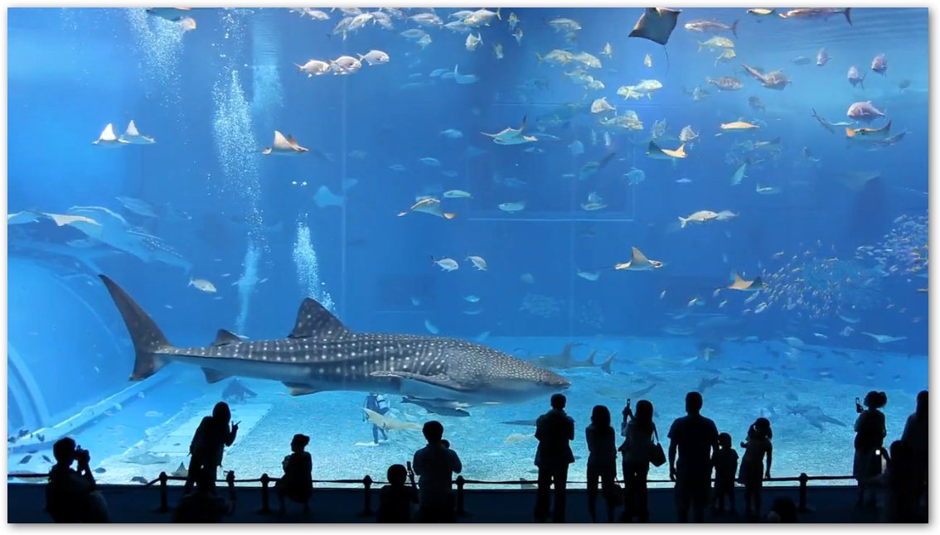
Aquarium Theory
Footnote
Notes:
You need to decide which aquarium do you belong.
You need to be aware that this decision is very important for your career, on this step you need to think about where do you fit.
Which environment
where do you feel confortable
Where you can apply all your potencial

Slide 5

Make your own choices
Decision Maker
How your opinion can be important
Career Progression
Define your goals
Where do you fit?
You are the best, and now?
Think about your career.
Workstyle
Understand how you can be comfortable
Notes:
Decision maker:
How much big you are more your opinion will worth and more recognicion you will get, ‘Com um grande poder vem uma grande responsabilidade’
Need to be carefull about the others opinion and space
On big companies you get less importance, that’s normal.
Career Progression
Imagine that you pick a small aquarium that is growing you will grow with the aquarium, but if the aquiarum do not grow you will be stuck
When you choose your aquarium you need to understand if they offer you a career plan, progression + salary
Keep learning and learning to grow up
You are the best and now?
Now, you change simple as that. Quando és o melhor do grupo significa que a tua curva de aprendizagem já está a descer, portanto está na Altura de procurar um novo desafio
WorkStyle
Find the best place where you fit. Understand yourself if you want to work in a team or alone, regardless of your choose be honest with yourself
Find what motivates you, find what is more important for you

Slide 6
Start from the scratch
Fight your fears
What I want?
Where do I want to live?
Should I go to programming (but I hate programing)?
I want to go but I am not ready…
I really need to continue on the same field of my Master thesis?
Who will employ me?
Get your answers
Think want make you smile and get committed into it
Think about your family, your closest friends and your next adventures
Get advices from the old students
Take the risk
You have a new world in front of you, no stings attached. Choose by yourself.
Thrust in your skills and be proactive
Notes:
Don’t Whine About Your Mistakes, Learn from Them –Bill gates
stop blaming other people just to try and rid your conscience of guilt.
Be Committed and Passionate –Grande empreendedores
You need to be committed to what you love and have great passion for what you do.
The successful people in this world make it look so easy because they absolutely love what they are doing.
Life is Not Fair (get used to it) -Bill
Life isn’t fair. It’s a test, a game, a risk. If you fall down and don’t bother getting back up, you don’t deserve to be successful. Winners know that life isn’t fair and they will keep getting back up until they’ve made it.
Be Proud of Who You Are -Bill
Each person has their own unique abilities and you have to accept that to become successful.

Slide 7

Interview - Be prepared for all questions
Research about the requirement's of the position.
Research about the business areas of the company.
Create a draft of your career plan.
Answer the question: ”Why should we hire you?”
Be yourself.
Thrust on yourself.
Notes:
There was a quote:
Your value is worthless to us, We just will pay you want we want.
Is hard to define your market value because you don’t know how much do your worth.
Value your work and value yourself.
Quantify your value as a worker, how much the company can win with you.
Reference:
http://www.salary.com/knowing-what-you-re-worth-3-Keys-to-Determine-Your-Market-Value/

Slide 8
Understand your skills

Slide 9
Discover your Strong skills and create your Brand
Technical
Languages (Programming)
Infrastructures
Communication Protocols
Logical Thinking
Troubleshooting
Programming Patern’s
Soft
Communication
Side activities
Hobbies
Interests
Work Style
Sport activity
Resiliency
Social
Lifestyle
Group activities
Team Player
Be Part of the group
Notes:
O que te define enquanto profissional

Slide 10
Empower Yourself
Define short term Goals (monthly)
Attend a training
Achieve a metric
Research about new implementations
Help your colleagues
Learn something new
Reward yourself
Define Long term Goals (10 years)
Achieve the title
Get a raise
Create a company
Work on a Big Company
Reward yourself
Notes:
Don’t Whine About Your Mistakes, Learn from Them –Bill gates
stop blaming other people just to try and rid your conscience of guilt.
Be Committed and Passionate –Grande empreendedores
You need to be committed to what you love and have great passion for what you do.
The successful people in this world make it look so easy because they absolutely love what they are doing.
Life is Not Fair (get used to it) -Bill
Life isn’t fair. It’s a test, a game, a risk. If you fall down and don’t bother getting back up, you don’t deserve to be successful. Winners know that life isn’t fair and they will keep getting back up until they’ve made it.
Be Proud of Who You Are -Bill
Each person has their own unique abilities and you have to accept that to become successful.

Slide 11

Keep rewarding yourself
Define your Goal
Define what your what to achieve and why.
Reach the Goal
Work to reach your goal, never give up.
Reward
Reward yourself and define another Goal.

Slide 12
Be S.M.A.R.T.
Specific What, Why, Who, Where and Which.
Measurable How much, How many and achievement
Achievable How can I achieve and realistic.
Relevant
Worth? Right Time? Should I do it? Is applicable?
Time-bound
When?
Notes:
Your goal should be clear and specific, otherwise you won't be able to focus your efforts or feel truly motivated to achieve it. When drafting your goal, try to answer the five "W" questions:
What do I want to accomplish?
Why is this goal important?
Who is involved?
Where is it located?
Which resources or limits are involved?
2. Measurable
It's important to have measurable goals, so that you can track your progress and stay motivated. Assessing progress helps you to stay focused, meet your deadlines, and feel the excitement of getting closer to achieving your goal.
A measurable goal should address questions such as:
How much?
How many?
How will I know when it is accomplished?
3. Achievable
Your goal also needs to be realistic and attainable to be successful. In other words, it should stretch your abilities but still remain possible. When you set an achievable goal, you may be able to identify previously overlooked opportunities or resources that can bring you closer to it.
An achievable goal will usually answer questions such as:
How can I accomplish this goal?
How realistic is the goal, based on other constraints, such as financial factors?
4. Relevant
This step is about ensuring that your goal matters to you, and that it also aligns with other relevant goals. We all need support and assistance in achieving our goals, but it's important to retain control over them. So, make sure that your plans drive everyone forward, but that you're still responsible for achieving your own goal.
A relevant goal can answer "yes" to these questions:
Does this seem worthwhile?
Is this the right time?
Does this match our other efforts/needs?
Am I the right person to reach this goal?
Is it applicable in the current socio-economic environment?
5. Time-bound
Every goal needs a target date, so that you have a deadline to focus on and something to work toward. This part of the SMART goal criteria helps to prevent everyday tasks from taking priority over your longer-term goals.
A time-bound goal will usually answer these questions:
When?
What can I do six months from now?
What can I do six weeks from now?
What can I do today?

Slide 13
Keep improving your knowledge
Tips:
See sharp
Use all the Opportunities to learn something
Challenge yourself
Never regret about some error
Take the lead of your ideas
There is no stupid Ideas
Actions:
Proactive
Learn with the mistakes
Learn with the others mistakes
Try and test new things
Follow your instinct
Be always ready
Notes:
Don’t Whine About Your Mistakes, Learn from Them –Bill gates
stop blaming other people just to try and rid your conscience of guilt.
Be Committed and Passionate –Grande empreendedores
You need to be committed to what you love and have great passion for what you do.
The successful people in this world make it look so easy because they absolutely love what they are doing.
Life is Not Fair (get used to it) -Bill
Life isn’t fair. It’s a test, a game, a risk. If you fall down and don’t bother getting back up, you don’t deserve to be successful. Winners know that life isn’t fair and they will keep getting back up until they’ve made it.
Be Proud of Who You Are -Bill
Each person has their own unique abilities and you have to accept that to become successful.

Slide 14
I am not a leader and now?
Myers Briggs Personality types
[E- I] Extraversion and Introversion
[S – N] Sensing and Intuition
[T – F] Thinking and Feeling
[J – P] Judgment and Perception
Notes:
People and things (Extraversion or "E"), or ideas and information (Introversion or "I").
Facts and reality (Sensing or "S"), or possibilities and potential (Intuition or "N").
Logic and truth (Thinking or "T"), or values and relationships (Feeling or "F").
A lifestyle that is well-structured (Judgment or "J"), or one that goes with the flow (Perception or "P").
Src: http://www.teamtechnology.co.uk/tt/t-articl/mb-simpl.htm

Slide 15
How to be successful?

Slide 16
How to achieve the success
"The secret of success in life is for a man to be ready for his opportunity when it comes.“ -- Benjamin Disraeli
Footnote

Slide 17
Wartegg test
Notes:
O teste consiste em uma folha com 8 quadrados de tamanho de 16 cm² cada. Quem faz o teste da continuidade a um desenho já iniciado; são relatadas a ordem em que estes foram feitos; são dados nomes aos desenhos; é dito pelo o grau de dificuldade de execução de cada desenho; e qual desenho o candidato mais gostou e menos gostou.

Slide 18
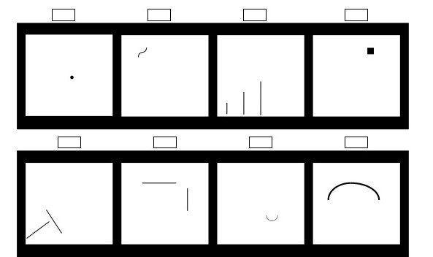
Wartegg test – Challenge

Slide 19
Wartegg test – Description PT
1 – Shows the ability to adapt to new environment
2 – Emotional flexibility
3 – Motivation to go forward
4 – Shows the ability to overcome difficulties or problems
5 – Show how one individual take action and make decisions
6 – Shows Analytical ability
7 – Depicts one’s feeling and emotions
8 – Shows how he/she build or stablish their social interaction
Notes:
1 - É a representação do próprio indivíduo
2 - É o íntimo e afetivo.
3 - Ambição
4 - Agressividade, angústia
5 - Energia
6 - Razão pela lógica
7 - Sexualidade
8 - Futuro, equilíbrio mental
Src: http://gth.krammerbuch.at/sites/default/files/articles/Create%20Article/05Roivanen-KORR2.pdf
Src: https://books.google.com.br/books?id=LtnOY_1i7mQC&pg=PA262&dq=Teste+de+Wartegg&ei=0q4ES6LUGZHYyQTV_8GQBA&client=firefox-a&hl=en#v=onepage&q=Teste%20de%20Wartegg&f=true
Src: https://pt.slideshare.net/rimbunjobagency/tips-on-handling-psychological-assessment

Slide 20
Thank you ☺

Slide 21
Join Microsoft.
Mach program: Https://careers.microsoft.com/students/mach
Job apply: https://careers.microsoft.com
Notes:
People and things (Extraversion or "E"), or ideas and information (Introversion or "I").
Facts and reality (Sensing or "S"), or possibilities and potential (Intuition or "N").
Logic and truth (Thinking or "T"), or values and relationships (Feeling or "F").
A lifestyle that is well-structured (Judgment or "J"), or one that goes with the flow (Perception or "P").
Src: http://www.teamtechnology.co.uk/tt/t-articl/mb-simpl.htm

